Slide 1


Office of the Under Secretary of Defense (Comptroller)
Office of the Deputy Chief Financial Officer
Audit 101
Notes:
Ensure the size of the OSD logo is 1.5 X 1.5 and the size of the ODCFO logo is 1.5 X 1.47.

Slide 2
Contents
What Is a Financial Statement Audit?
Purpose of Financial Statement Audit
What Is a Financial Statement Auditor Looking for?
Standard Phases of an Audit
Audit Opinions
Audit 101 Example: Auditing Property

Slide 3
What Is a Financial Statement Audit?
Audit Defined
Auditing is the collection and evaluation of evidence to support an opinion on the reliability of the financial statements of an entity.
Auditor’s Responsibility
Management Responsibility
Express an opinion based on tests performed against accounting and auditing standards.
Summarize and present issues found to management: Notice of Findings and Recommendations (NFR).
Preparation and presentation of the financial statements.
Design, implementation and maintenance of internal controls and systems.
Retain supporting documents to support financial events.
Remediate NFRs reported through the audit.
A financial statement audit is not a one-time “check-the-box” exercise

Slide 4
Purpose of Financial Statement Audit
Purpose
The primary purpose of a financial statement audit is to provide an opinion about whether an entity’s financial statements are presented in conformity with generally accepted accounting principles (GAAP).
Importance
Transparency: Visibility into how DoD accounts for funding.
Accuracy: DoD transactions are recorded correctly and free from error.
Audit
Reliability: DoD processes and systems can be trusted and are dependable.
Accessibility: Proof of how DoD spends funding is obtainable in a timely fashion.

Slide 5
What Is a Financial Statement Auditor Looking for?
Reliability of Financial Statements & Underlying Information
Completeness
Existence or Occurrence
Accuracy/
Valuation
Rights and Obligations
Presentation & Disclosure
Is anything missing?
Do they have it or did it really happen?
Are the numbers right?
Do they own or owe what they think they do?
Is it recorded in the right place?

Slide 6
Standard Phases of an Audit
Testing Period
Phase 1:
Planning
Phase 2:
Internal Control
Phase 3:
Substantive
Testing
Phase 4:
Reporting
Phase 5:
Post-Audit Remediation and Sustainment
Phases of the Audit
Post-Audit Phase
Entrance Conference
Understand entity’s operations
Initial analytical procedures to determine test plan
Initial documentation requests
SAS 99: Fraud analysis
Understand systems and business processes
Determine nature and extent of testing of controls
Assess internal control design and operating effectiveness
Assess Compliance with Federal Financial Management Improvement Act of 1996 (FFMIA)
Design tests of transactions
Perform transaction level testing
Provide KSDs for transactions
Aggregate test results (internal controls and substantive testing)
Conclude audit procedures
Form an opinion
Exit conference
Issue audit report
Track and monitor notice of findings and Recommendations (NFRs)
Implementation of corrective action plans (CAPs) for identified weaknesses
Report status of CAPs to OUSD(C)
Regularly Occurring Status Meetings
Audits will be continuous and ongoing – an annually recurring cycle

Slide 7
Audit Opinions
At the conclusion of a financial statement audit, the auditor will issue one of the following opinions on the entity’s financial statements:
Audit Opinion |  | Definition
Unmodified |  | No material or pervasive errors noted
Modified | Qualified | Material but not pervasive errors or the inability to obtain sufficient appropriate evidence
 | Adverse | Misstatements are both material and pervasive
 | Disclaimer | Unable to obtain appropriate evidence on which to base the opinion, and undetected misstatements could lead to errors that are both material and pervasive

Slide 8
Conclusion
Financial statement audits require a strong working relationship between the auditor, OUSD(C), Reporting Entities, Service Providers, and Principal Staff Assistants (PSAs)
Financial statement audits will require discipline and cooperation, but will facilitate the business reform and readiness essential to supporting the Warfighter
8

Slide 9
Audit 101 Example: Auditing Property

Slide 10
Example: Auditing Property Balances
When auditing property balances, auditors will look at several areas:
Are all of the assets the agency uses included in the property records?
Do the property records include assets that do not exist or have been disposed?
Are the assets correctly valued?
The tests auditors perform vary based on the financial statement line item(s) being audited

Slide 11
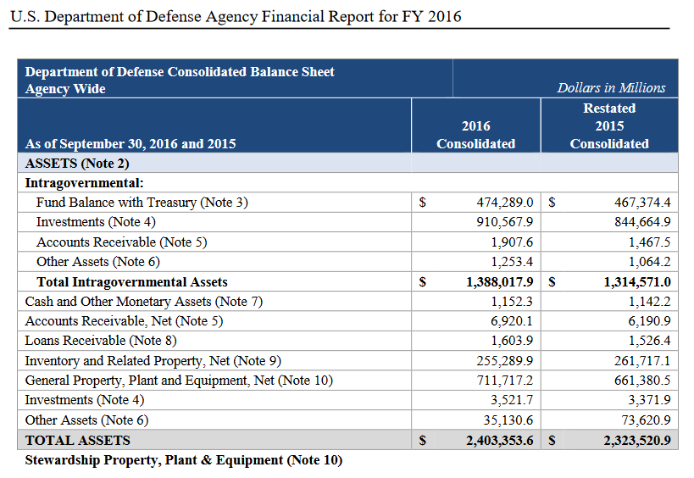
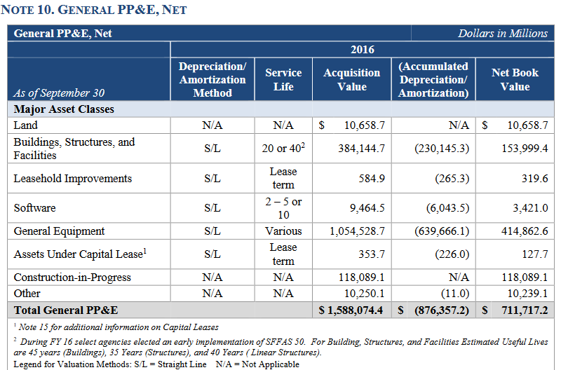
Auditing Property
Comparing Financial Statement and Footnote Balances
Auditors compare the balance sheet and statement notes
Calculate the current year activity
CY activity = CY – PY
50,336.7= 711,717.2 – 661,380.5
Notes:
Stoplight
Accomplishments
Next Steps
Risks
Status Report
Milestones
Color Coding
Goals
Summary
Workstreams
Template

Slide 12
Auditing Property
Comparing Footnotes to Property Records
Note balances are compared to the Property Ledgers
Notes:
Stoplight
Accomplishments
Next Steps
Risks
Status Report
Milestones
Color Coding
Goals
Summary
Workstreams
Template

Slide 13
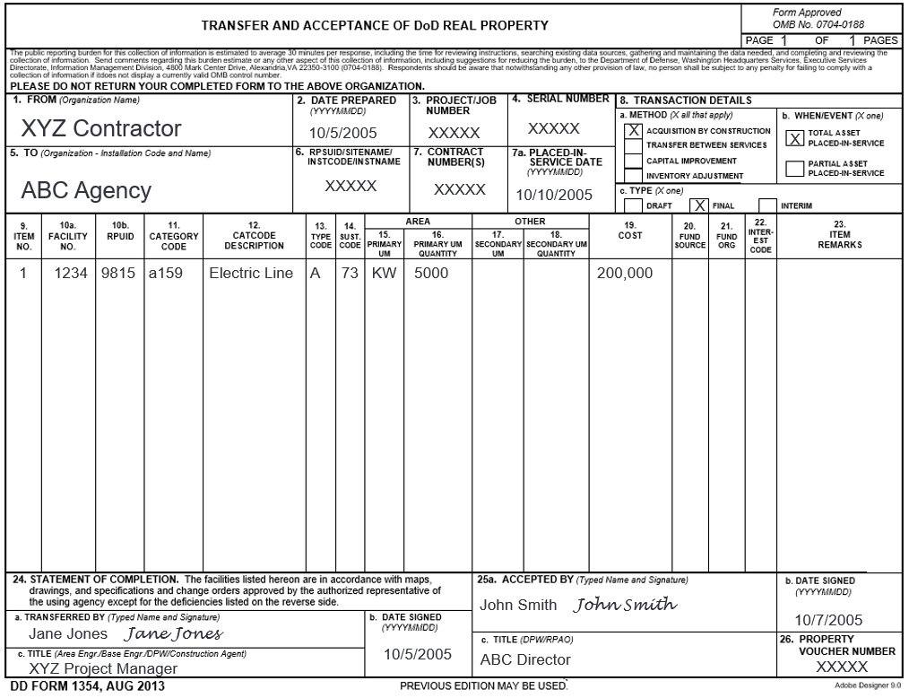
Auditing Property
Comparing Property Records to Supporting Documentation
Are Assets Correctly Valued
Does the Documentation Support the Balances
Does the support match the:
Asset Name
Cost
In Service Date
Signed acceptance
Date DD 1354 signed
Who Signed
Notes:
Stoplight
Accomplishments
Next Steps
Risks
Status Report
Milestones
Color Coding
Goals
Summary
Workstreams
Template

Slide 14
Auditing Property
☒
☑
☑
☑
☑
☒
☑
Testing for Completeness and Existence
Do all included assets exist?
Are all capitalized assets included?
☑ - Found Onsite
☒ - Not Found Onsite
Notes:
Stoplight
Accomplishments
Next Steps
Risks
Status Report
Milestones
Color Coding
Goals
Summary
Workstreams
Template

